Slide 1
TOPIC
21MEB0B26 – KANDI NARSIMHA REDDY
21MEB0B40 – MD ANSARI
Material identification by Ultrasonic wave propagation through cylindrical rod using ai.

Slide 2
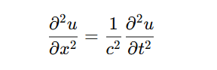
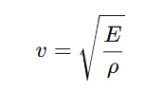
INTRODUCTION
Wave Equation: Describes how waves propagate through a medium.
General form:
Where c is the wave speed, u is the displacement, and t, x are time and space variables
Relation Between Wave Speed & Material Properties:
In solids, wave speed depends on elasticity and density.
Speed of longitudinal waves in a rod:

Slide 3
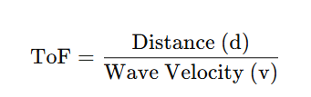
INTRODUCTION
E = Young’s Modulus (Elasticity)
ρ = Density of the material
Since different materials have different E and ρ values, their wave speeds vary.
Time of flight : The time taken by an ultrasonic wave to travel through a material

Slide 4
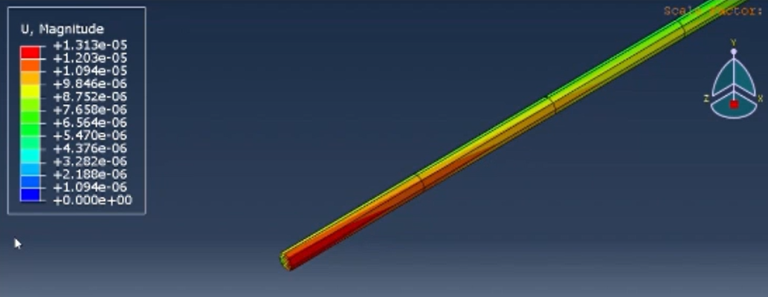
OBJECTIVE
Project: AI-Based Material Identification Using Ultrasonic Waves
Objective: Identify materials by analysing ultrasonic wave propagation through a cylindrical rod.
Method:
Sensors measure the Time of Flight (ToF) of ultrasonic waves.
Different materials alter wave propagation due to density & acoustic impedance.
AI-Based Classification:
Uses a Decision Tree algorithm for material classification.
Inputs: ToF and wave characteristics.
Applications:
Quality control in manufacturing.
Non-destructive testing (NDT).
Industrial material sorting for automation.

Slide 5
EXISTING INVENTIONS
WAVEGUIDE TECHNIQUE FOR THE SIMULTANEOUS MEASUREMENT OF TEMPERATURE DEPENDENT PROPERTIES OF MATERIALS.
MULTI-LEVEL TEMPERATURE MEASUREMENTS USING ULTRASONIC WAVEGUIDES.
ULTRASONIC WAVEGUIDE BASED MULTILEVEL TEMPERATURE SENSOR FOR CONFINED SPACE MEASUREMENTS.
ULTRASONIC WAVEGUIDE TECHNIQUE FOR SENSING AND MEASUREMENTS OF PHYSICAL AND CHEMICAL PROPERTIES OF SURROUNDING MEDIA.
AND MANY MORE..
BY
Dr. Suresh P
Dr. Karthik Balasubramanian

Slide 6
LITERATURE REVIEW
Fundamentals of Ultrasonic Testing: Researchers such as Krautkrämer & Krautkrämer (1990) established the foundation of ultrasonic NDT, emphasizing wave behavior in different mediums.
Time of Flight Measurement: ToF-based methods have been widely adopted for evaluating material properties. Research by Rose (2014) highlights how ToF analysis aids in determining thickness, density, and elastic modulus of materials.
Decision Tree Algorithms in Ultrasonic NDT: Decision trees offer an interpretable and efficient approach to classifying materials based on extracted wave features. Studies by Bishop (2006) and Hastie et al. (2009) show that decision trees are well-suited for pattern recognition in signal processing applications.

Slide 7
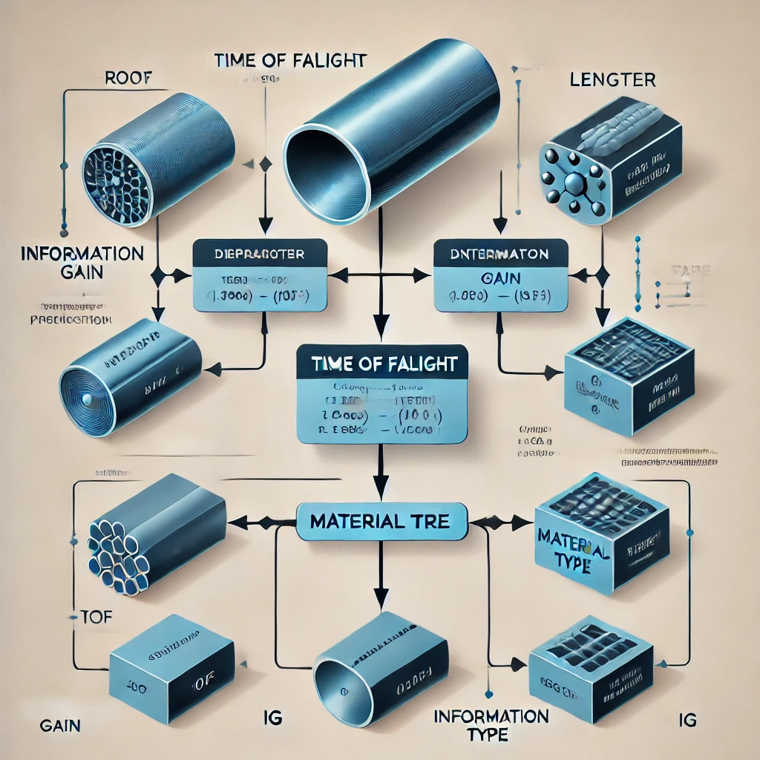
NOVALTY
The integration of AI-based prediction, specifically using a decision tree model, for material identification in this project is a novel approach compared to existing ultrasonic testing methods. While traditional techniques rely solely on wave propagation characteristics such as time of flight (ToF), attenuation, and velocity, the use of AI enhances classification accuracy by learning complex patterns in the data. This advancement differentiates the present project from previous studies, making material identification more efficient, automated, and adaptable to diverse applications.

Slide 8
ASSUMPTIONS:
DAMPING EFFECTS OF SURROUNDING MEDIA IS NEGLECTED.
ABAQUS NUMERICAL SOLVER CALCULATIONS ARE APPROXIMATED.
TIME OF FLIGHT VALUES ARE APPROXIMATED BETWEEN TOLERANT VALUES.
TEMPERATURE EFFECTES ARE NEGLECTED.
VALUES MAY DIFFER WITH REAL TIME EXPERIMENT.

Slide 9
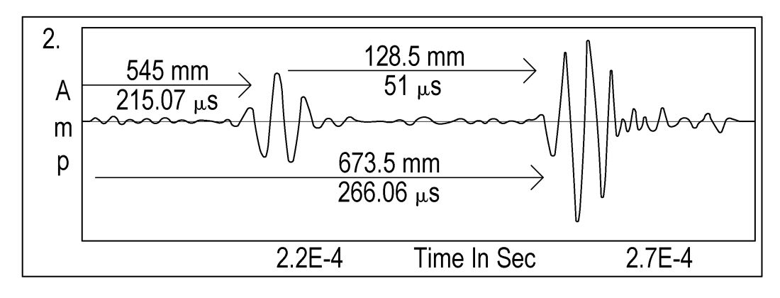
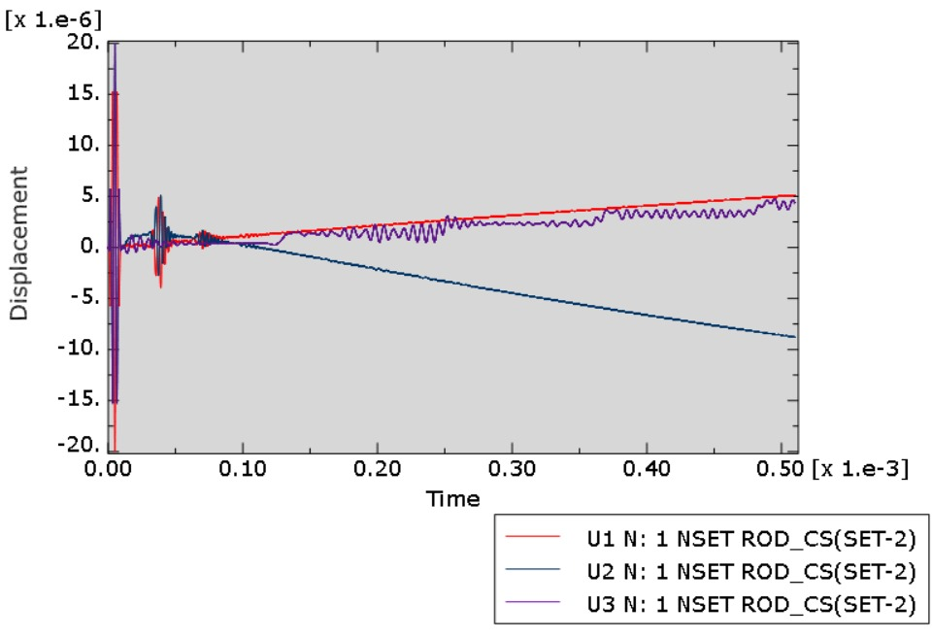
METHODOLOGY
This amplitude vs time graph is different for different material which depends on the cylindrical rod material characteristics, This particular graph provides input data for the decision tree to predict the material characteristics of the cylindrical rod.
The input data is the cylindrical rods diameter, length, and time of flight of the wave through the cylindrical rod upon which we compare the time of flight of the wave through a unknown cylindrical rod so that the trained AI based decision tree model would predict the material of the cylindrical rod.
RESEARCH PAPERS AMP vs TIME
ABAQUS AMP vs TIME History output graph

Slide 10
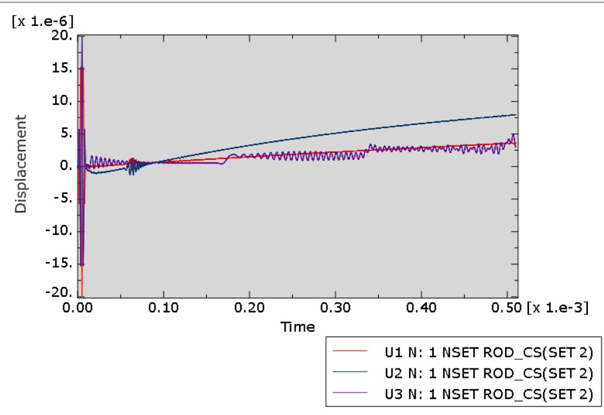
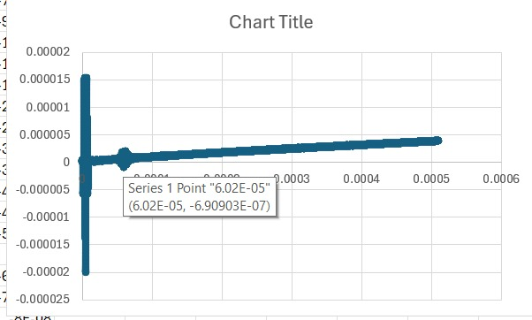
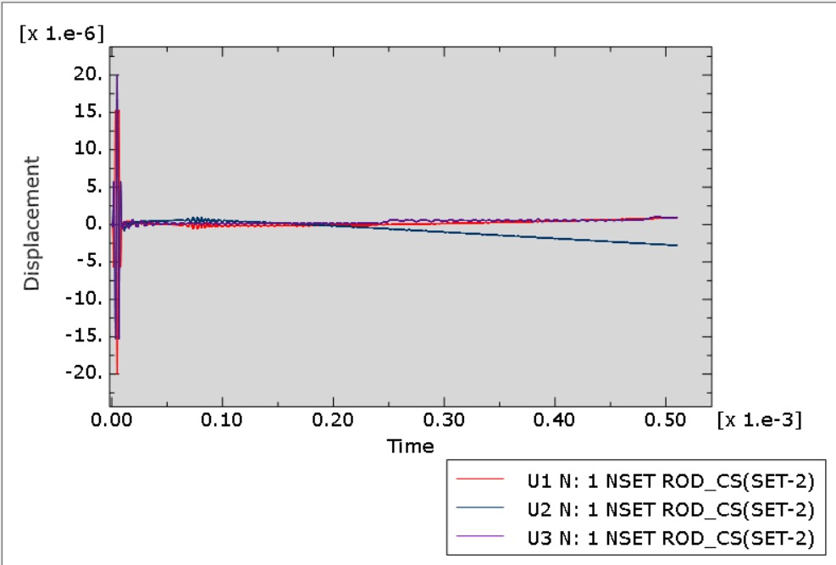
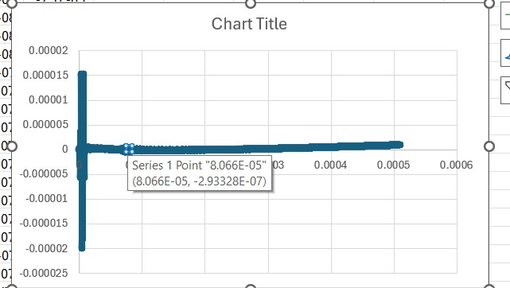
DISCUSSION ON RESULTS
TIME OF FLIGHT FOR DIFFERENT MATERIALS AND LENGTH OF THE MATERIAL
TIME OF FLIGHT FOR DIFFERENT MATERIAL
ZIRCONIUM
CHROMIUM

Slide 11
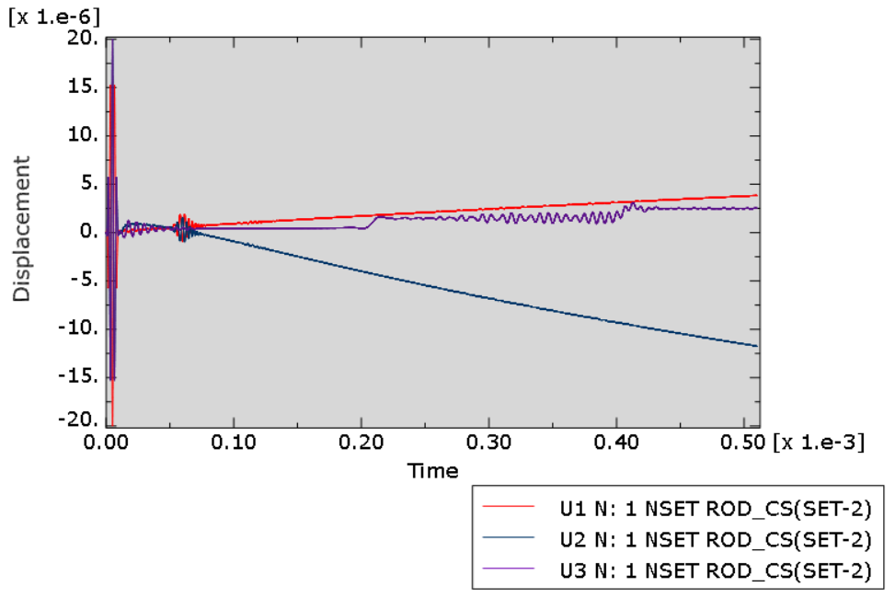
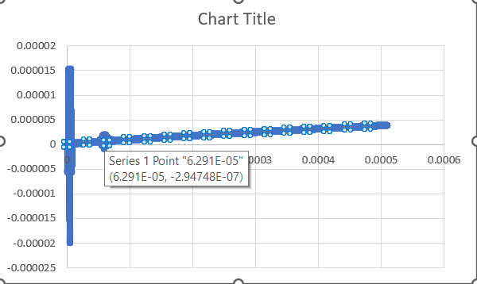

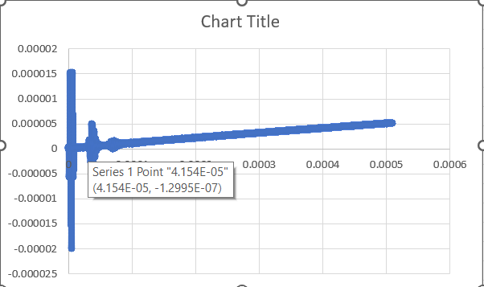
TIME OF FLIGHT FOR DIFFERENT LENGTHS
STAINLESS STEEL ( LENGTH = 0.5 )
STAINLESS STEEL ( LENGTH = 0.3 )

Slide 12
DERIVATION FOR GOVERNING EQUATION OF WAVE PROPAGATION:
The wave equation describes how waves propagates in a medium.
The general form of the 1D wave equation is:
where:
u(x,t) represents the displacement of the wave,
C is the wave speed,
x is the spatial coordinate,
t is time.

Slide 13
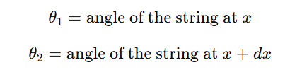
Derivation of the 1D Wave Equation
Step 1: Consider a Small Element of a Vibrating String
Let’s derive this equation for a transverse wave on a string.
Consider a string under tension T along the x-axis.
Let u(x,t) represent the transverse displacement of the string at position x and time t.
Take an infinitesimally small segment of the string between x and x+dx.
Step 2: Forces Acting on the Element
The tension force T acts on both ends of the string.
Since the string is curved, the tension forces have different angles at x and x+dx.

Slide 14
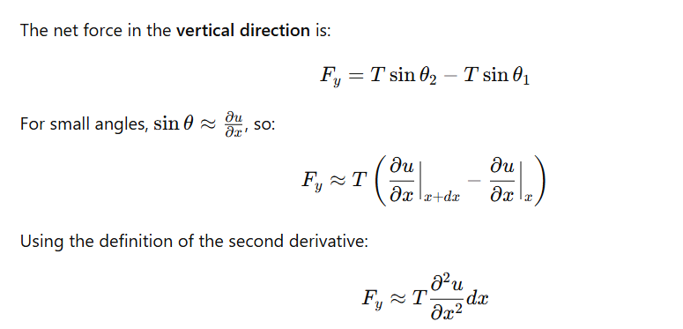
DERIVATION

Slide 15
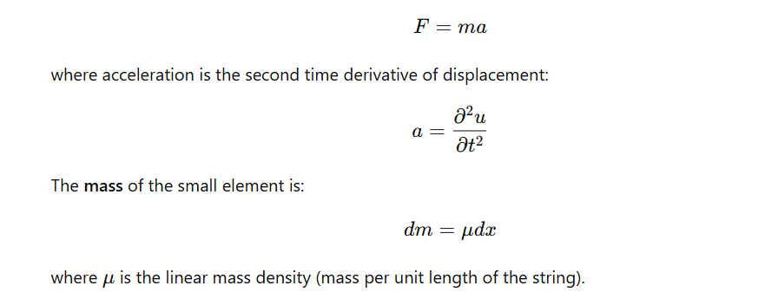
DERIVATION
Step 3: Apply Newton’s Second Law
Newton’s Second Law states:

Slide 16
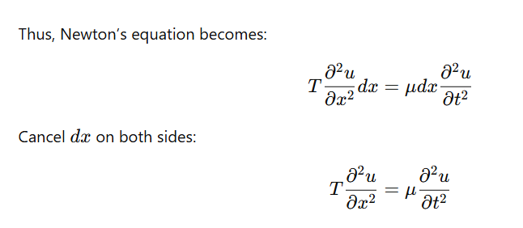
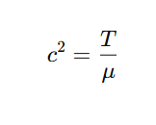
DERIVATION
Step 4: Define the Wave Speed
Wave speed c is given by:

Slide 17
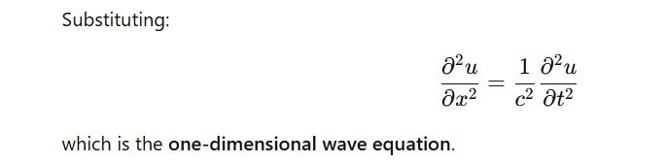
DERIVATION

Slide 18
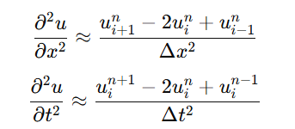
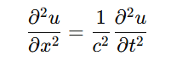
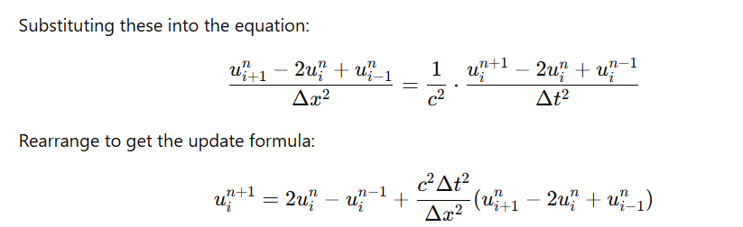
APPLYING NUMERICAL METHOD ( CTCS ) ON GOVERNING EQUATION
GOVERNING EQUATION
APPLYING CENTRAL IN TIME AND CENTRAL IN SPACE TO GOVERNING EQUATION….
USING THIS EQUATION IN MATLAB CODE

Slide 19
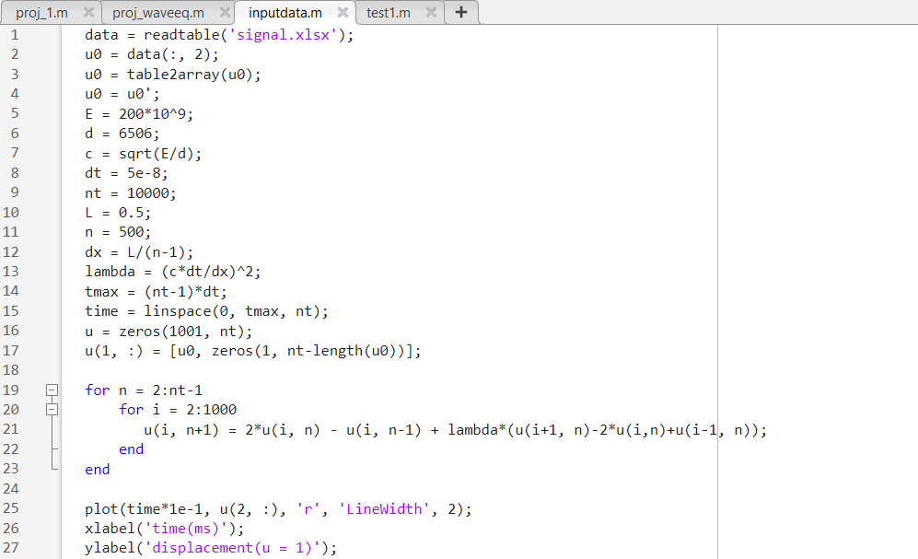
MATLAB CODE

Slide 20
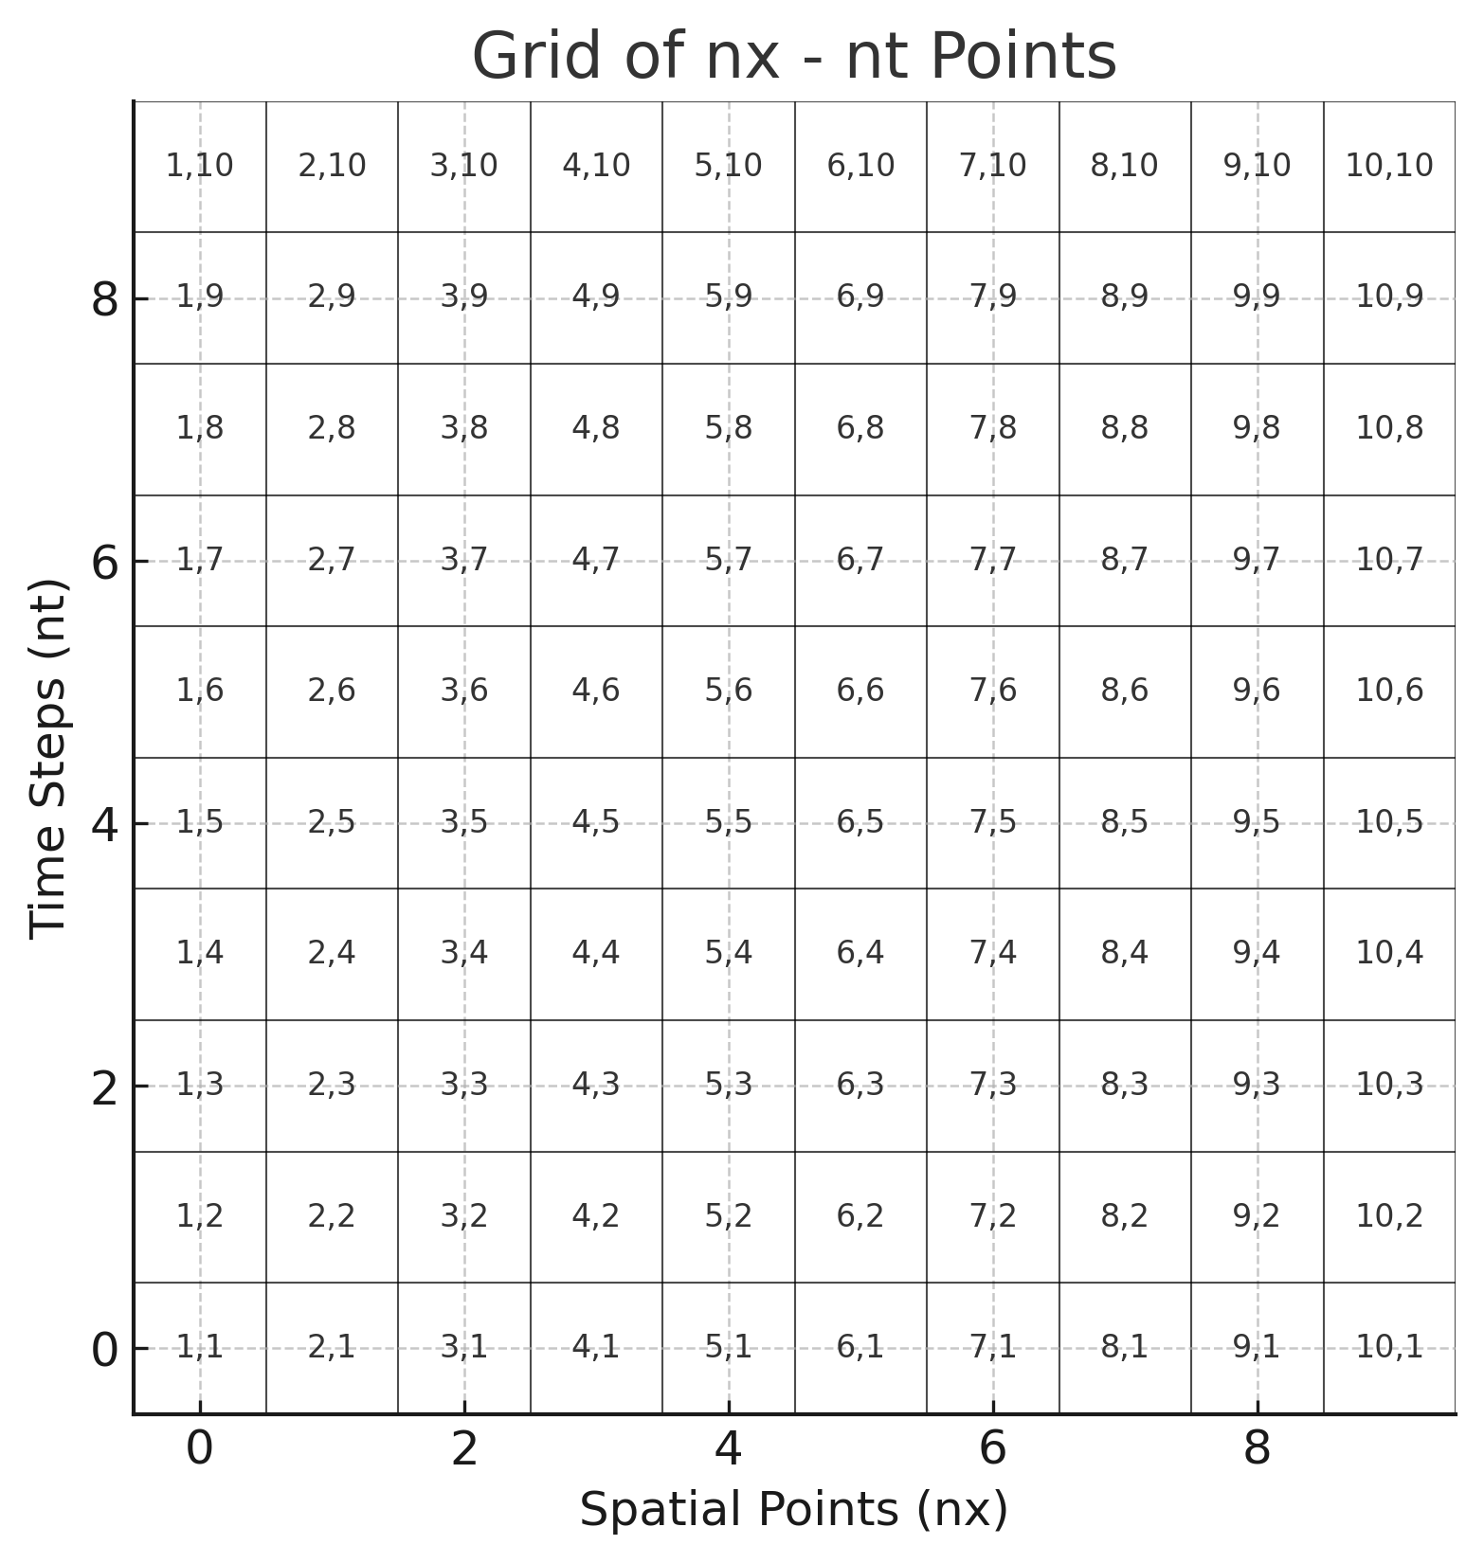

Slide 21
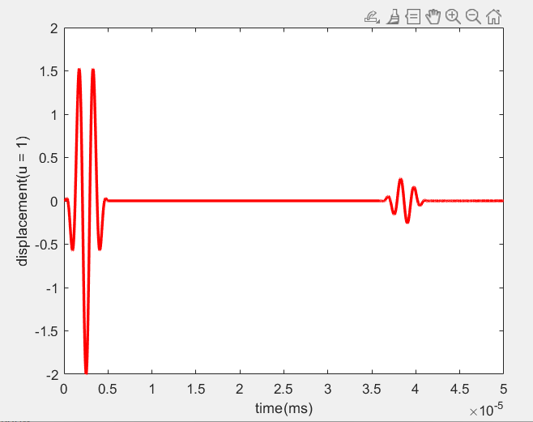
VALIDATION WITH MATLAB RESULT:
ABAQUS SOLVER RESULT
MATLAB CODE RESULT

Slide 22
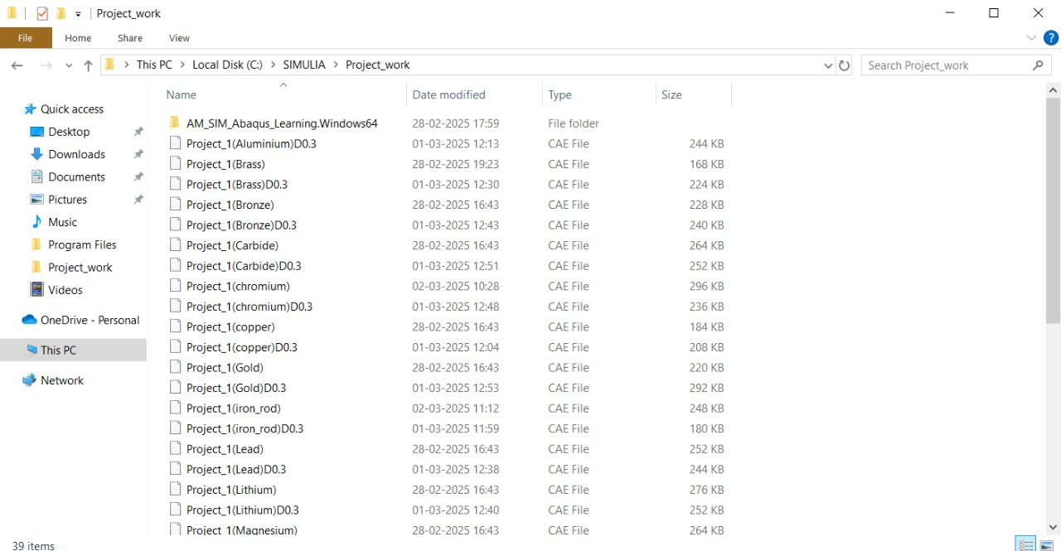
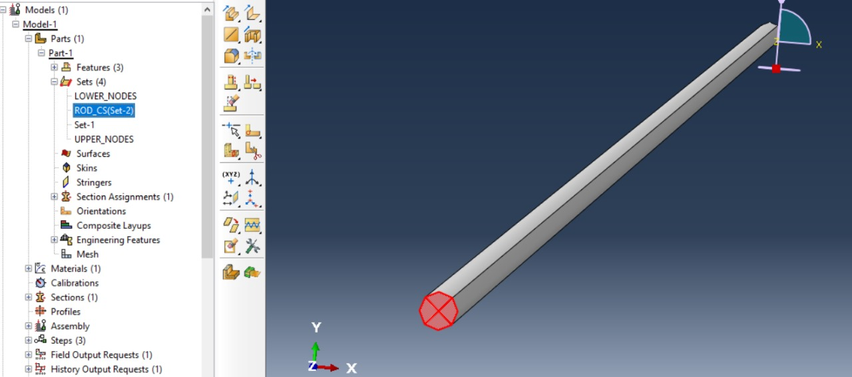
WORK DONE UPTO NOW
DATA COLLECTION:
Data includes time of flight for different materials acquired through abaqus simulia.
VALIDATION CODE:
Written matlab code for validation purpose.
SIMULATIONS:
Simulation of wave propagation through cylindrical rod for 18 different materials and 2 different lengths for each material.

Slide 23
REMAINING WORK
DATA COLLECTION IN TABLES:
Accumulation of data into tables in excel to use them as training data for AI.
CODING PART OF AI:
Decision Tree model coding in python, or java script.
VALIDATION:
Validation of predicted values through AI with correct data to find out error and accuracy of data and further tuning to improve accuracy of the AI model.

Slide 24
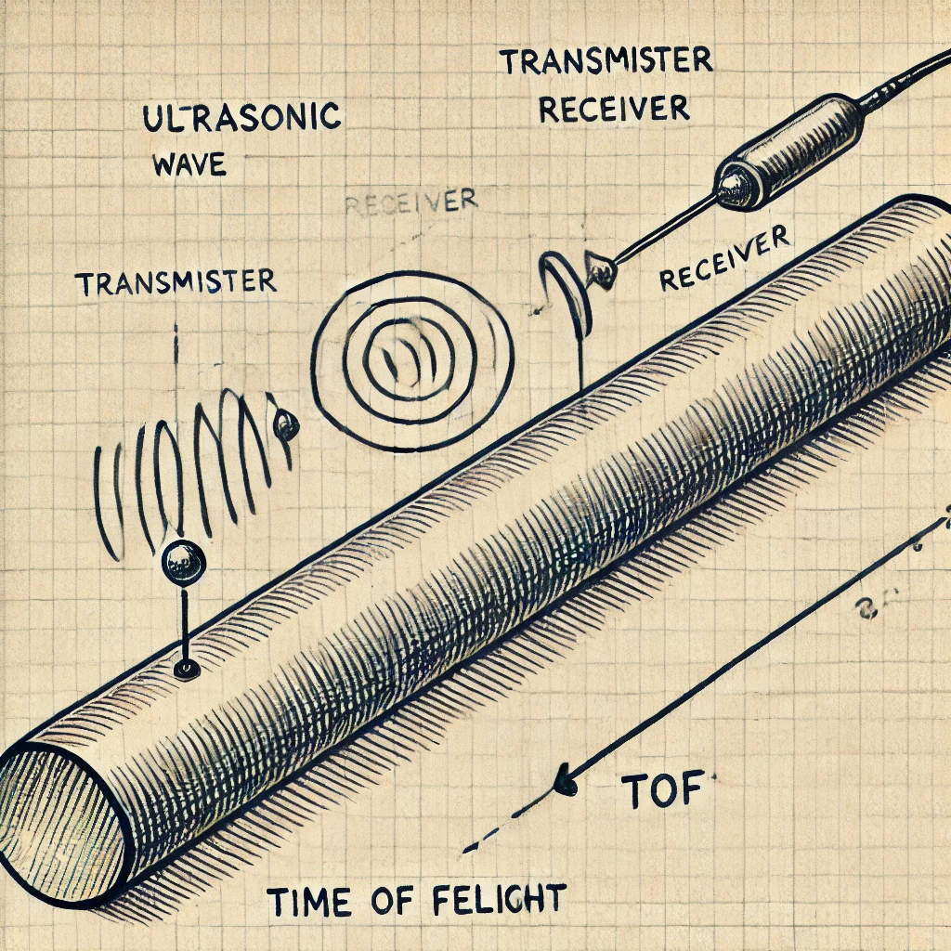
SCOPE FOR IMPROVEMENT
Real time implementation of the present project using a receiver and transmitter of the signal into the cylinder
To calculate the time of flight of the waves and determine the material of the cylinder using AI.
SENSORS
Use of one transmitter and receiver along the cylinder length
AI MODEL
A Decision tree or any other AI model to predict material
PREDICTION
Validation of predicted values with the actual data to find error

Slide 25
CONCLUSION
The integration of AI techniques with finite element simulations in Abaqus Simulia for material prediction based on time-of-flight (ToF) data presents a promising approach for material characterization. The key takeaways from this study are:
Enhanced Material Identification: AI models trained on ToF data can accurately predict material properties, reducing the need for extensive physical testing.
Efficiency and Automation: The AI-driven approach automates the material classification process, minimizing human effort and improving decision-making speed.
High Accuracy with Data-Driven Models: Machine learning algorithms, such as neural networks and regression models, effectively capture patterns in ToF data, leading to precise material predictions.
Robustness Across Different Materials: The AI model can generalize well when trained with diverse datasets, making it applicable to a wide range of materials.
Potential for Real-Time Applications: With further optimization, AI-based material prediction can be integrated into real-time non-destructive evaluation (NDE) systems.
Scalability and Adaptability: The framework can be extended to various simulation environments and experimental setups, making it highly versatile.

